Slide 1
PREDICTING AND VISUALIZING COVID 19
BY
R.SAI.THARUN VTU10130
P.PRUDHVI VTU10178

Slide 2
INTRODUCTION
There is an obvious concern globally regarding the fact about the emerging coronavirus 2019 novel coronavirus (2019‐nCoV) as a worldwide public health threat. As the outbreak of COVID‐19 causes by the severe acute respiratory syndrome coronavirus 2 (SARS‐CoV‐2) progresses within China and beyond, rapidly available epidemiological data are needed to guide strategies for situational awareness and intervention. The recent outbreak of pneumonia in Wuhan, China, caused by the SARS‐CoV‐2 emphasizes the importance of analyzing the epidemiological data of this novel virus and predicting their risks of infecting people all around the globe.

Slide 3
OBJECTIVES
Use the existing data and predicting the possible number of cases in the future.
Visualizing the data of the effected individuals in the country and also statewise.

Slide 4
Algorithm - ARIMA
Acronym for Auto Regressive Integrated Moving Average.
Auto Regressive : Lags of variables itself.
Integrated :Differencing steps required to make stationary.
Moving Average :Lags of previous information shocks.
It is a prediction model used for time series analysis & forecasting .
Time series is a collection of observations of well-defined data items obtained through repeated measurements over time.
A time series can also show the impact of cyclical, seasonal and irregular events on the data item being measured.

Slide 5
ARIMA - Parameters
A non seasonal ARIMA model is classified as an ARIMA(p , d , q)" model where:
p is the number of autoregressive terms.
d is the number of non seasonal differences needed for stationarity.
q is the number of lagged forecast errors in the prediction equation.

Slide 6
ASSUMPTIONS
The data series used by ARIMA should be stationary.
It means that the properties of the series doesn’t depend on the time when it is captured.
A Cyclic behavior can also be considered as stationary series.
A non stationary series is made stationary by differencing.
Data should be univariate - ARIMA works on a single variable. Auto-regression is all about regression with the past values.

Slide 7
ARIMA MODEL
Auto Regressive (AR) Model:
Value of a variable in one period is related to the values in previous period.
AR(p) - Current values depend on its own previous values.
P is the order of AR process .
Ex : AR(1,0,0) or AR(1)
Moving Average (MA) Model:
Accounts for possibility of a relationship b/w a variable & residuals from previous period.
MA(q) - The current deviation from mean depends on q- previous deviations.

Slide 8
ARIMA MODEL
q is the order of MA process .Only error terms are there.
Ex: MA(0,0,1) or MA(1)
ARMA Model:
Both AR and MA are there, ARMA(1,0,1) or ARMA(1,1)
ARIMA Model : if differencing term is also included ,i.e, ARIMA(1,1,1)=ARMA(1,1) with first differencing.

Slide 9
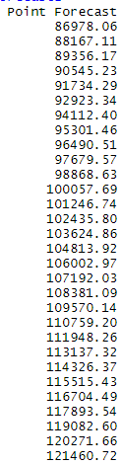
OUTPUT
RESULT OF PREDICTION:

Slide 10
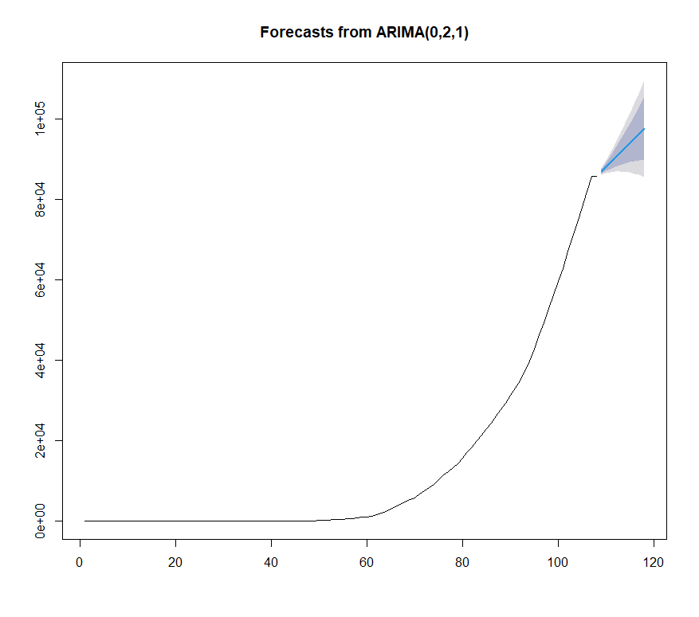
PLOT OF PREDICTION RESULT:

Slide 11
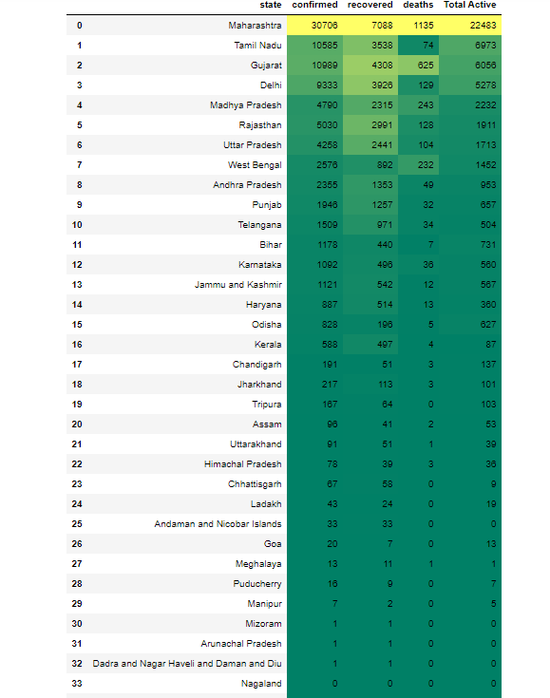
STATEWISE INFORMATION REGARDING COVID 19 (TOTAL CASES,RECOVERED AND DEATHS)

Slide 12
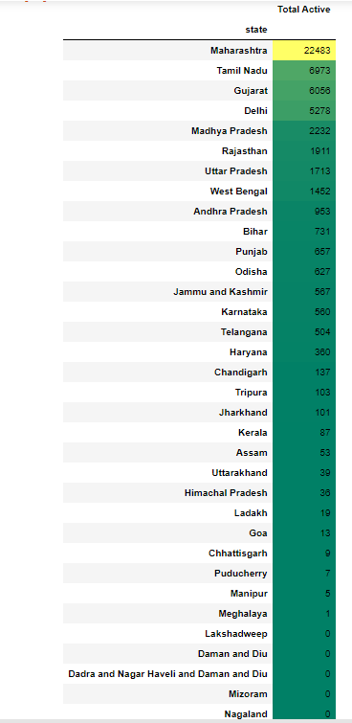
STATEWISE ACTIVE CASES OF COVID 19

Slide 13
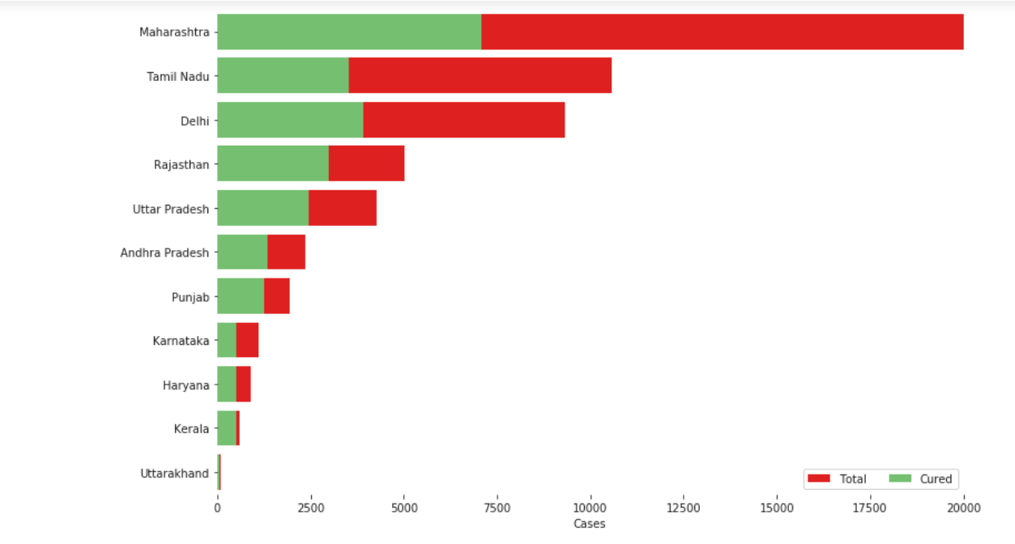
BAR PLOT VISUALISATION OF COVID 19 SITUATION IN INDIA

Slide 14
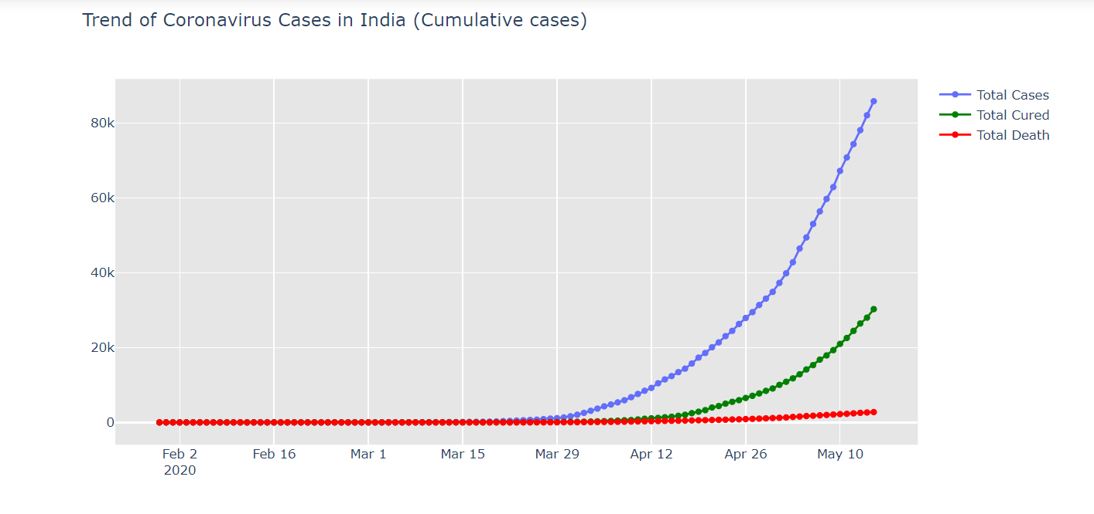
PLOTS OF COVID 19 CASES IN INDIA(TOTAL CASES,TOTAL CURED,TOTAL DEATHS)

Slide 15
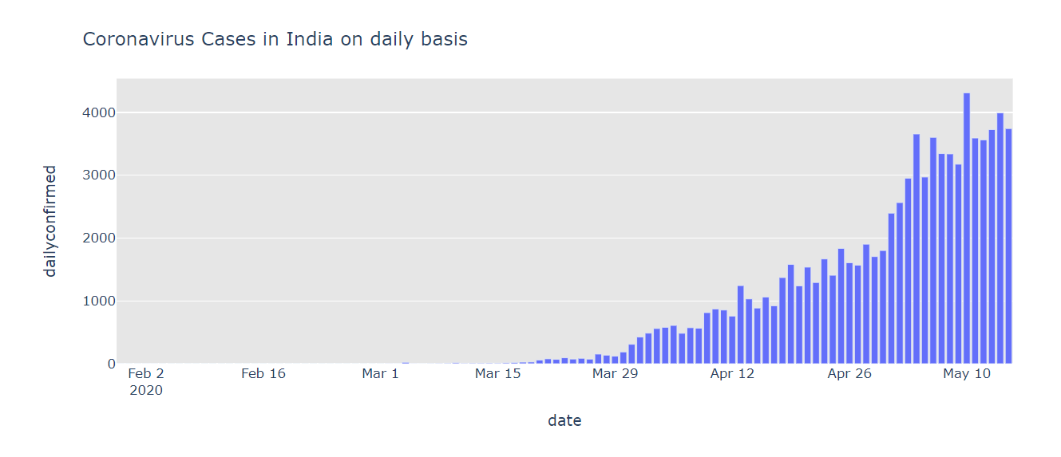

Slide 16
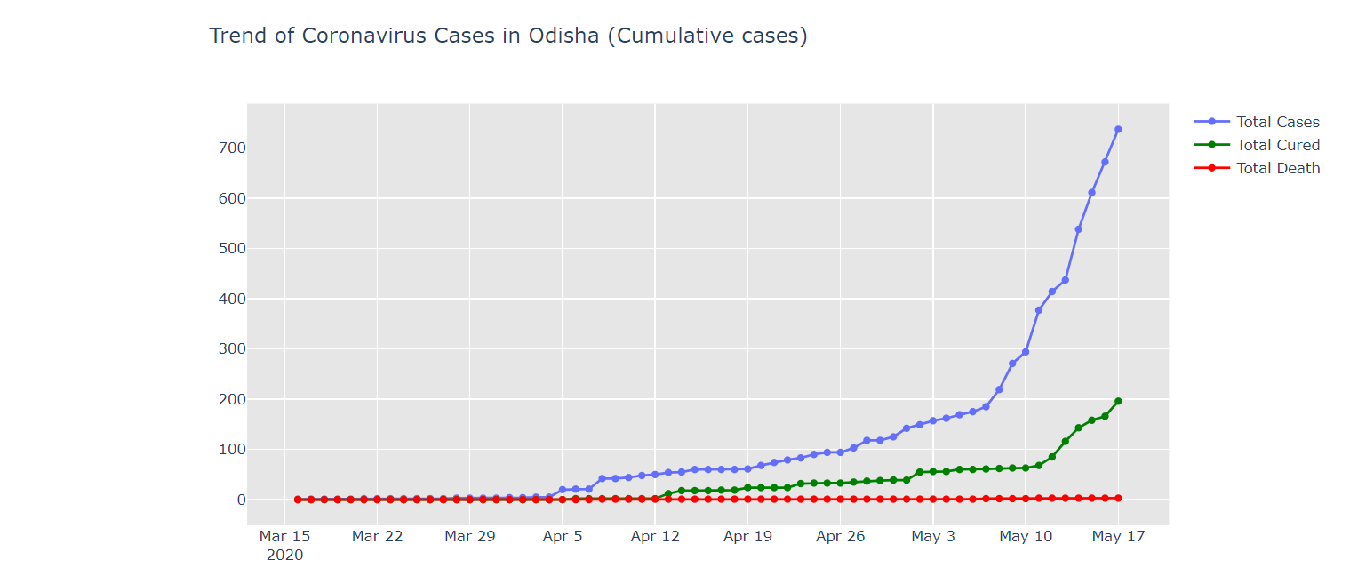
PLOTS OF COVID 19 CASES IN ODISHA(SIMILARLY STATE CAN BE SELECTED AND CORRESPONDING PLOTS WILL BE DISPLAYED

Slide 17
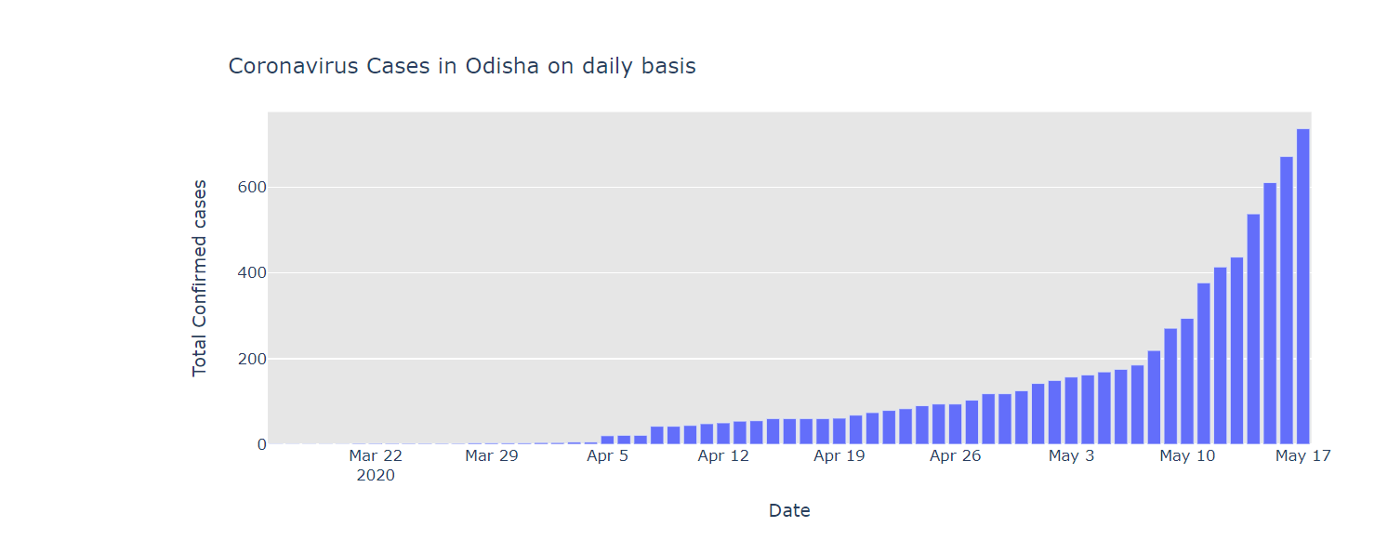

Slide 18
THANK YOU

